Slide 1
Practitioner Guidance
Perceptual subitising is the ability to look at small groups of objects and know how many there are without needing to count them.
The ability to subitise without counting is a vital skill for children to develop and practise, without feeling as though they should double-check by counting. Counting is a far more complex process.
Subitising is an important mathematical skill that leads on to the development of calculating skills, as children learn to see how a whole can be made of smaller groups/parts. This can be discussed with the children during this PowerPoint.
Tell the children you are going to show them some dots and you would like them to tell you what they see. You can hide the dots by clicking on ‘hide dots’. Click ‘show dots’ to reveal the dots.
Question Prompts
What did you see?
How did you see it?
Do we need to count or can we see there are (insert number)?
Can you see any groups/parts that make up the whole?
How could we show (insert number) in a different way?

Slide 2
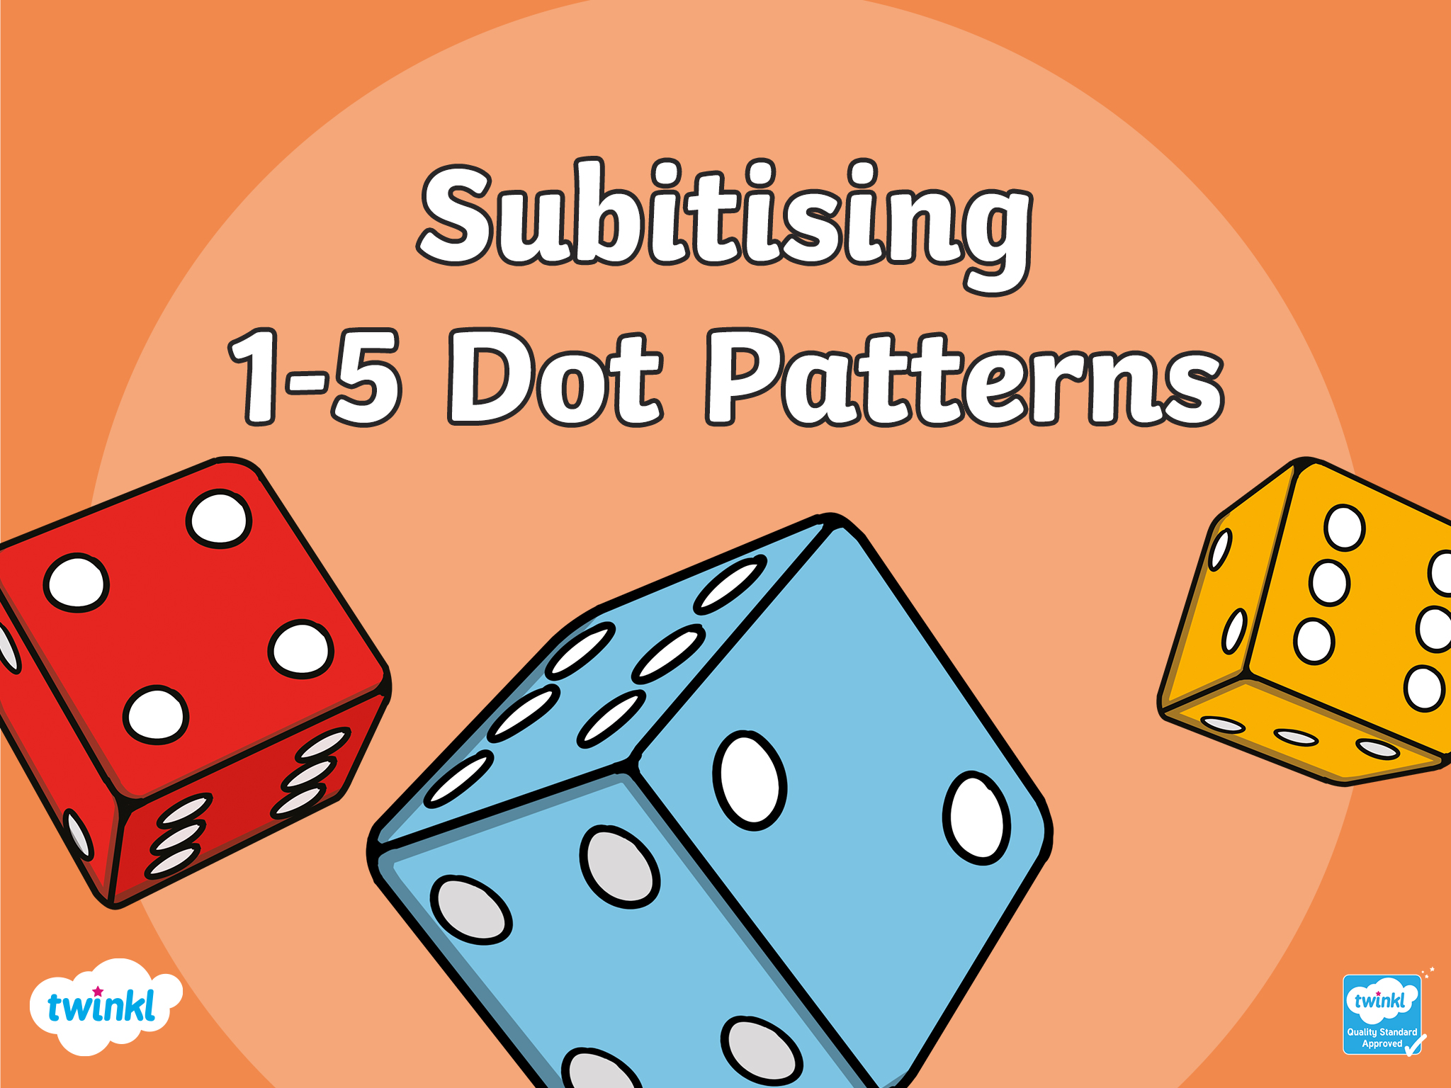

Slide 3
show dots
hide dots

Slide 4
show dots
hide dots

Slide 5
show dots
hide dots

Slide 6
show dots
hide dots

Slide 7
show dots
hide dots

Slide 8
show dots
hide dots

Slide 9
show dots
hide dots

Slide 10
show dots
hide dots

Slide 11
show dots
hide dots

Slide 12
show dots
hide dots

Slide 13
show dots
hide dots

Slide 14
show dots
hide dots

Slide 15
